Slide 1

I’m John R. Starr
Hi!

Slide 2
You can usually find me here:
FWS Instructor
(Psycho) linguist
Person?

Slide 3

What I think about a lot:
Are our brains like manual cars???
Wtf is language???
How do we process language???
How do we read???

Slide 4
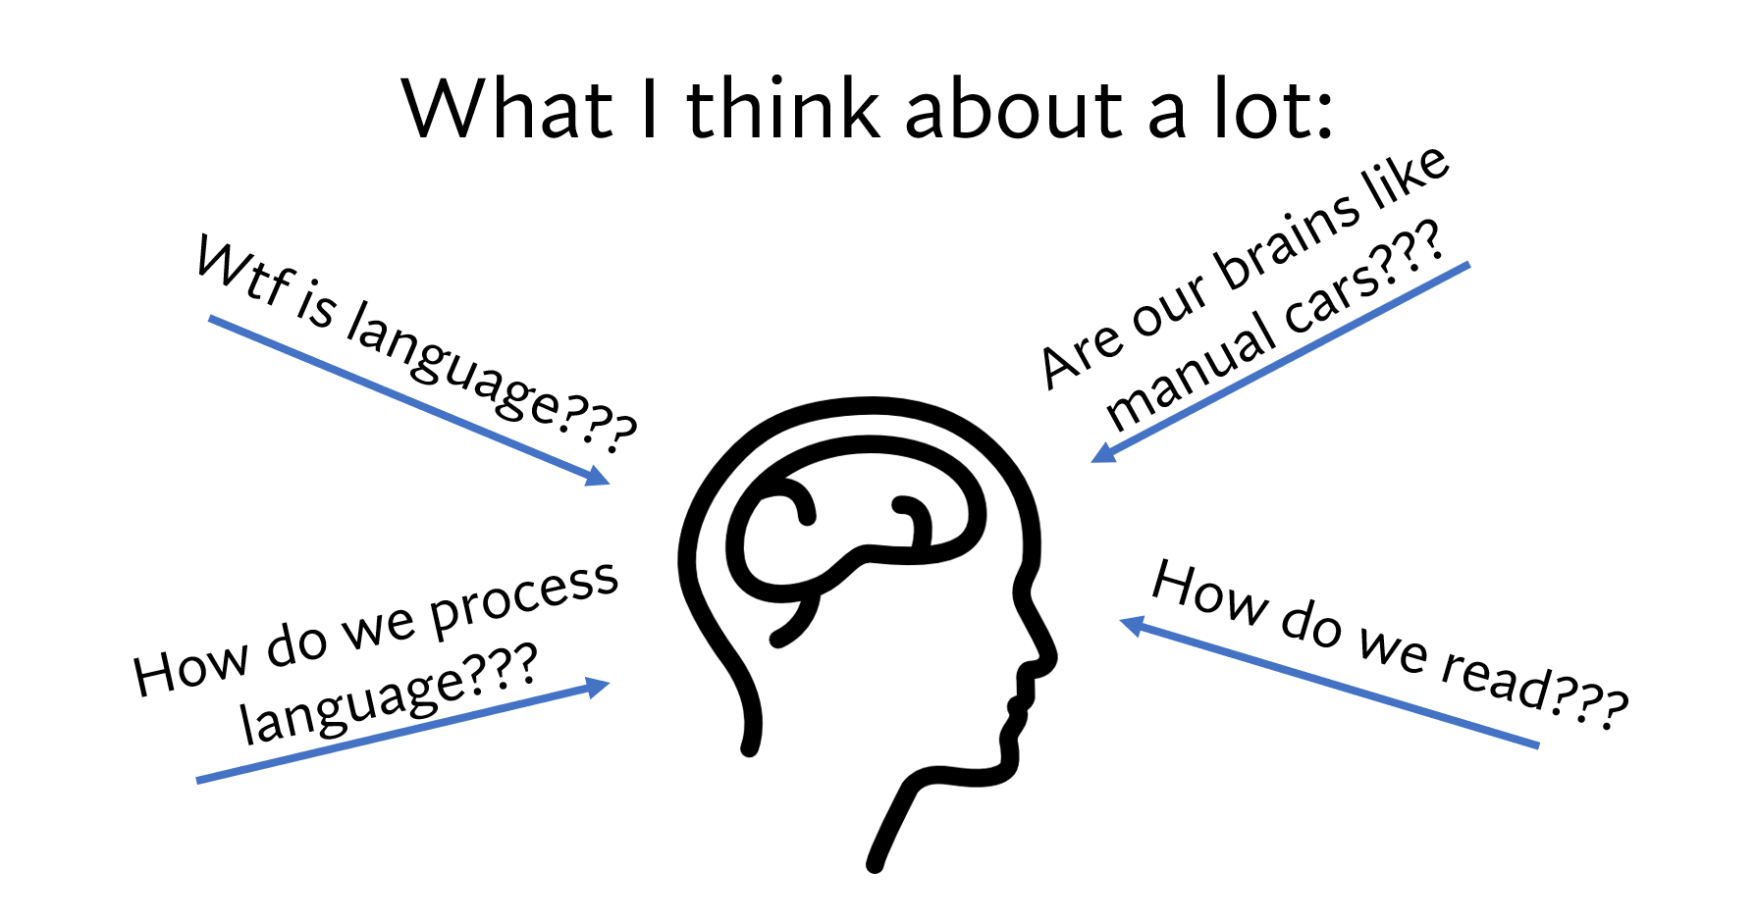
… but focusing on representations of sound (broadly defined)!

Slide 5
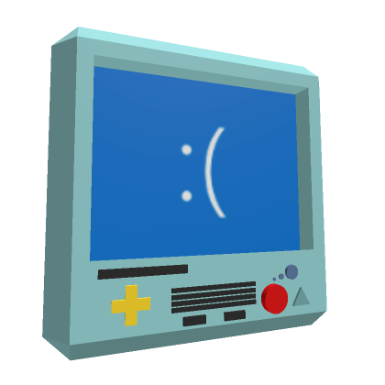
I spend a lot of time developing experiments for:
Ask me questions anytime!
… and how they inform each other
Humans
Language models (LMs)

Slide 6
Your First (?) Experiment
John R. Starr
LING 1100

Slide 7
We’ll focus on the what’s:
What is the purpose of experimenting?
What kinds of experiments are there?
What are the steps of an experiment?
What’s next?

Slide 8
1. What is the purpose of experimenting?

Slide 9



But how do we bridge this gap of understanding?
Understanding the world (and all that within its domain)

Slide 10




But how do we bridge this gap of understanding?
But other times, we need to collect data to answer our questions!
Sometimes, we’re good with sources!

Slide 11
2. What kinds of experiments are there?

Slide 12
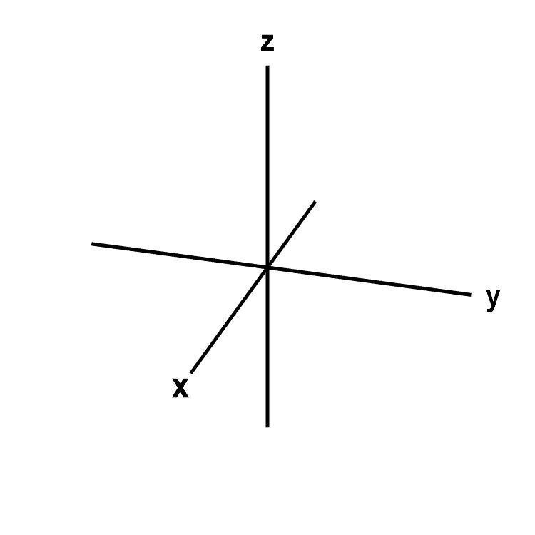
Axes* of experimentation
Quantitative or qualitative (or both?)
Exploratory or confirmatory (or both??)
Naturalistic or laboratory (probably not both??)
*Well, a few of them – this is certainly not all of them. These are the ones that matter most to you right now.

Slide 13
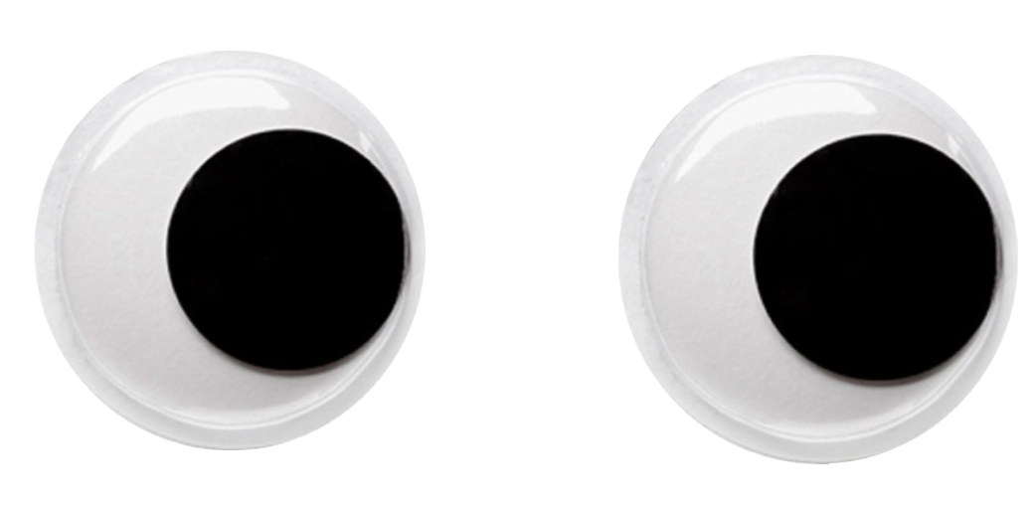
1. Quantitative or qualitative?
Experiments, statistical analyses, demographic information, etc.
Case studies, interviews, observations, etc.
QUANTITATIVE work mostly focuses on numbers (or countable statistics)!
QUALITATIVE work mostly focuses on non-numerical information!

Slide 14
2. Exploratory or confirmatory?
“I’m not so sure how things will turn out, but we could see…”
“Given prior work, we should see X, Y, and Z…”
EXPLORATORY
Degree of uncertainty
CONFIRMATORY

Slide 15

3. Naturalistic or laboratory?
Haha yeah!
Fr…
Corpus investigations, observation, media, etc.
Designed studies
NATURALISTIC approaches collect data from the wild!
LABORATORY approaches collect data from a controlled setting!

Slide 16
Your experiment is always multi-dimensional…
QUANTITATIVE
LABORATORY
CONFIRMATORY
EXPLORATORY
NATURALISTIC
QUALITATIVE

Slide 17
3. What are the steps of an experiment?

Slide 18
https://farm.pcibex.net/p/dPxkVB/
… but first, take the next five minutes:

Slide 19
Basic steps
Develop a research question (RQ)
Design/use a paradigm that addresses the RQ
Run the damn football thing!
Analyze the results

Slide 20
Basic steps
Develop a research question (RQ)
Design/use a paradigm that addresses the RQ
Run the damn football thing!
Analyze the results

Slide 21
What is a research question (RQ)?
Sorry for the ugly slide!
RQs should be concise and informed
Concise: the scope of the question should neither be too broad nor too narrow
Bad RQ: “How can we solve world peace?”
Good RQ: “How does economic status affect perception of personal and _________national safety in Southern Alabama?”
Informed: the question should derive (in part) from some prior work, though it does not necessarily need to extend that work
Bad RQ: “How do unicorns fly?”
Good RQ: “How do authors write about unicorn flight in children’s _________literature?

Slide 22
What do RQs do?
RQs should ask how an independent variable…
…affects a dependent variable
How does syntactic complexity…
… modulate saccade distance?

Slide 23
Sample RQs:
QUANTITATIVE or QUALITATIVE?
Do we read puns slower than non-puns, as suggested by prior work?
Do we enjoy reading puns over non-puns?
Are reading times of puns and enjoyment of puns positively correlated?
EXPLORATORY or CONFIRMATORY?
NATURALISTIC or LABORATORY?

Slide 24
Basic steps
Develop a research question (RQ)
Design/use a paradigm that addresses the RQ
Run the damn football thing!
Analyze the results

Slide 25
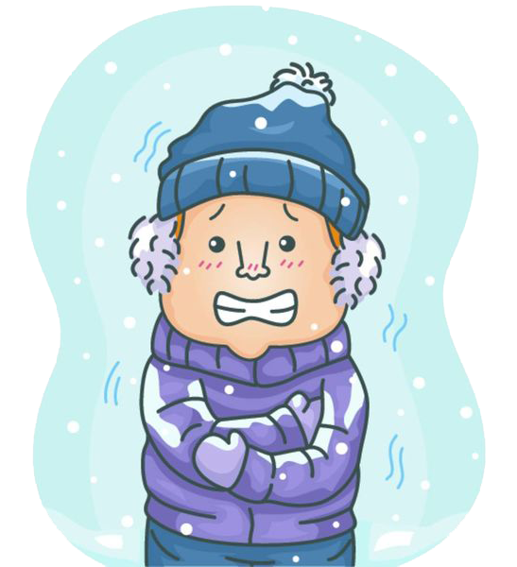
Some common experimental paradigms:
Rating tasks using either Likert scales [(1-5), (1-7)] or a slider:
How cold is Elara?
Very warm
Very cold
OR
Very warm
Very cold
Elara

Slide 26
Some more common experimental paradigms:
Short answer:
How do you think Elara is feeling?
Elara

Slide 27
Even more common experimental paradigms:
Fill-in-the-blank:
Right now, Elara feels very ________.
… but also, you can make your own paradigm!
Elara

Slide 28
Make some stimuli
How and what your stimuli look like is dependent on the experimental paradigm! Regardless, you’ll need to:
Decide what factors that you’re going to look at
Control (where possible) for other factors that could bias your results
This part takes a while… but it’s absolutely crucial!
No stimuli → no experiment!

Slide 29
I cannot stress this enough:
Double- and triple-check that your experimental paradigm and stimuli will directly provide results that address your research question(s)!!!

Slide 30
Things your experiment should have (1):
Instructions
Clarity on what the task is (but don’t give away what you’re looking at)
You can discuss what the task is for after people have completed the experiment
Payment if possible.
If not possible, I usually mention “Payment will be provided by the love and gratitude of the researcher”
Consent!!!
Collection of non-identifying demographic information (when necessary)

Slide 31
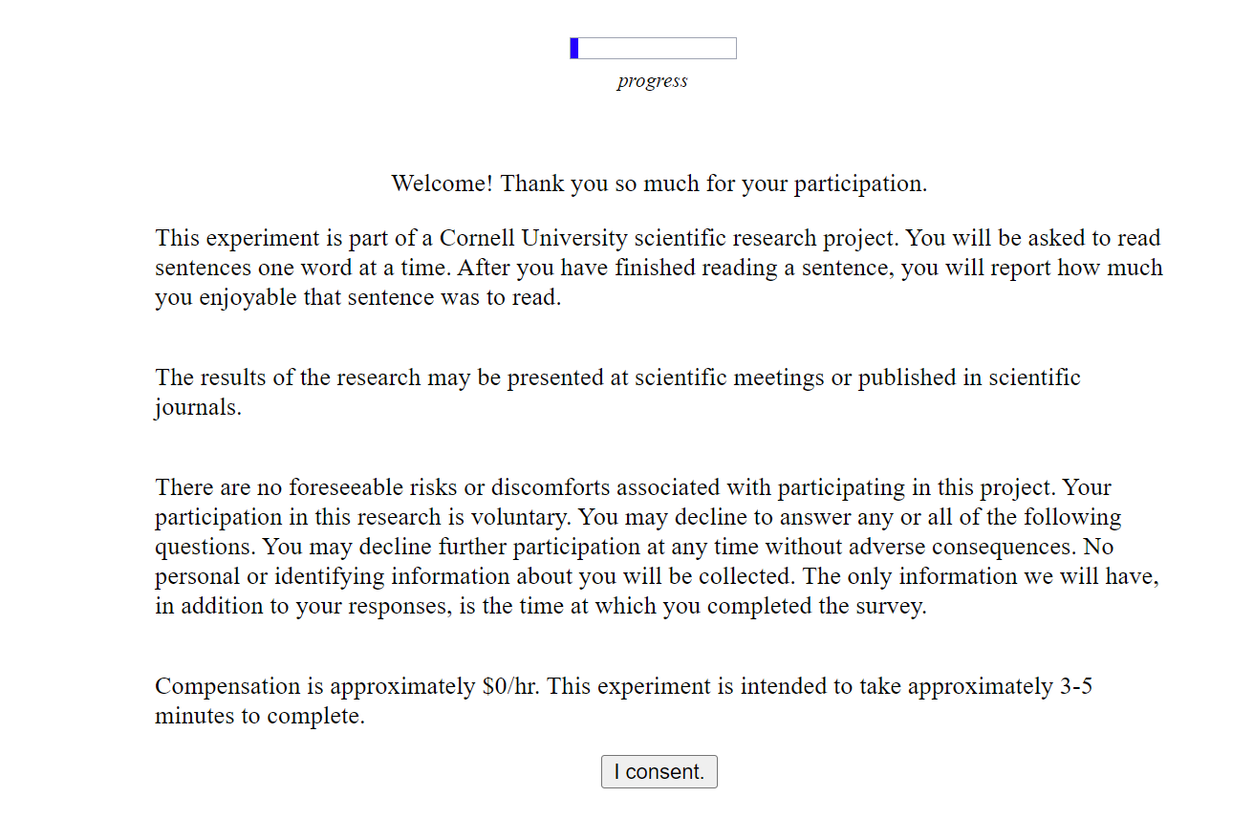
Consent & payment come first!

Slide 32
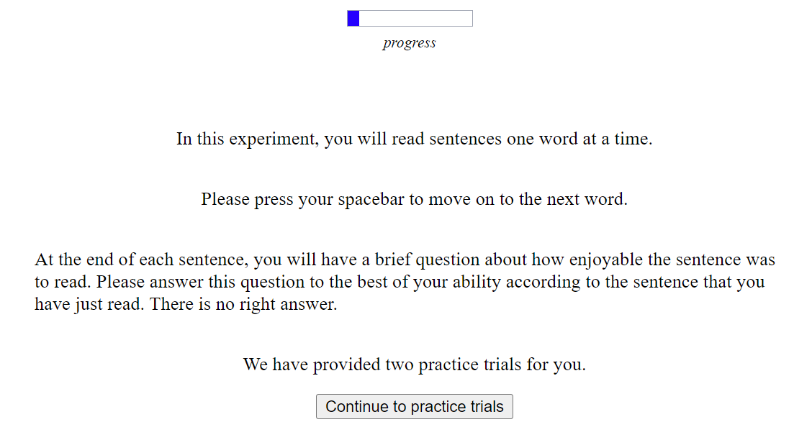
Instructions should 1) be clear, 2) minimize biases, and 3) inform the overall structure of the study.

Slide 33
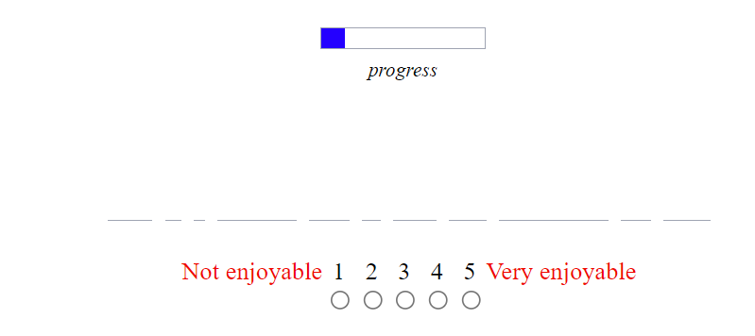
Things your experiment should have (2):
A few practice trials:
The participant needs to “warm up” to what you’re asking them to do.

Slide 34
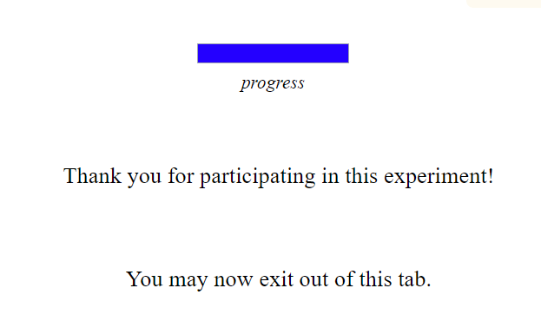
Things your experiment should have (3):
Some gratitude:
They just helped you out! Appreciate them!

Slide 35
Basic steps
Develop a research question (RQ)
Design/use a paradigm that addresses the RQ
Run the damn football thing!
Analyze the results

Slide 36
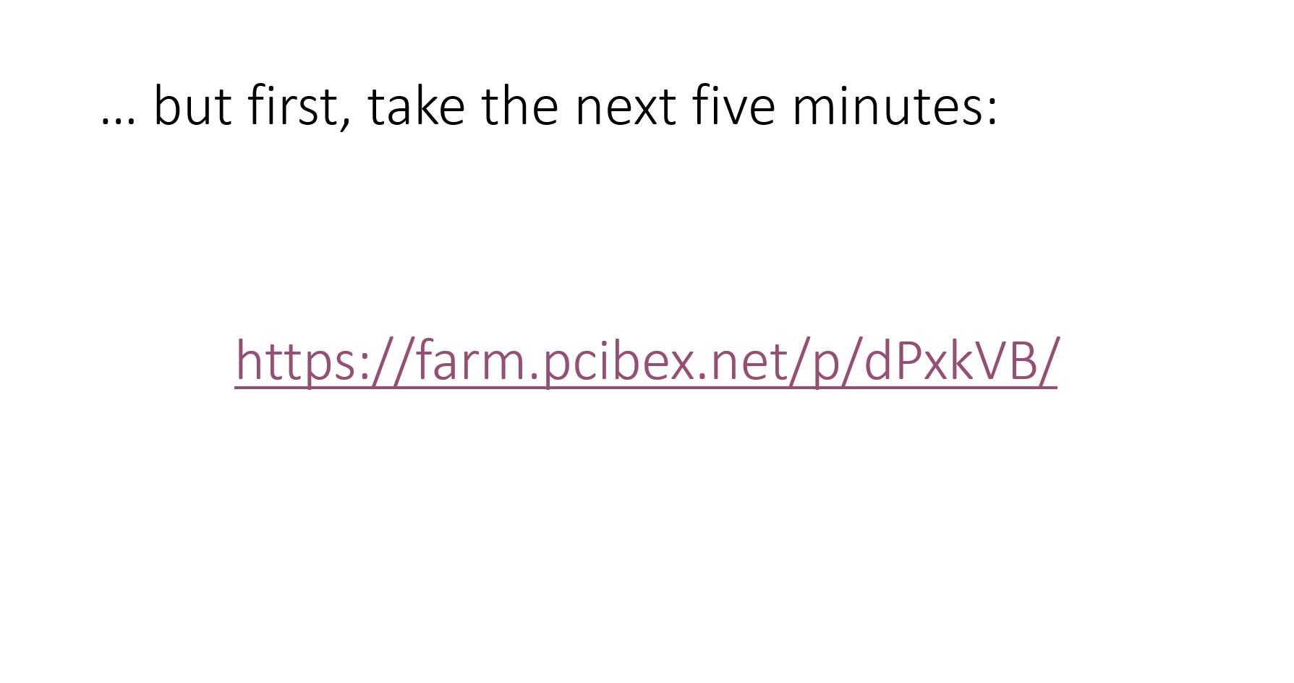
… remember me?

Slide 37
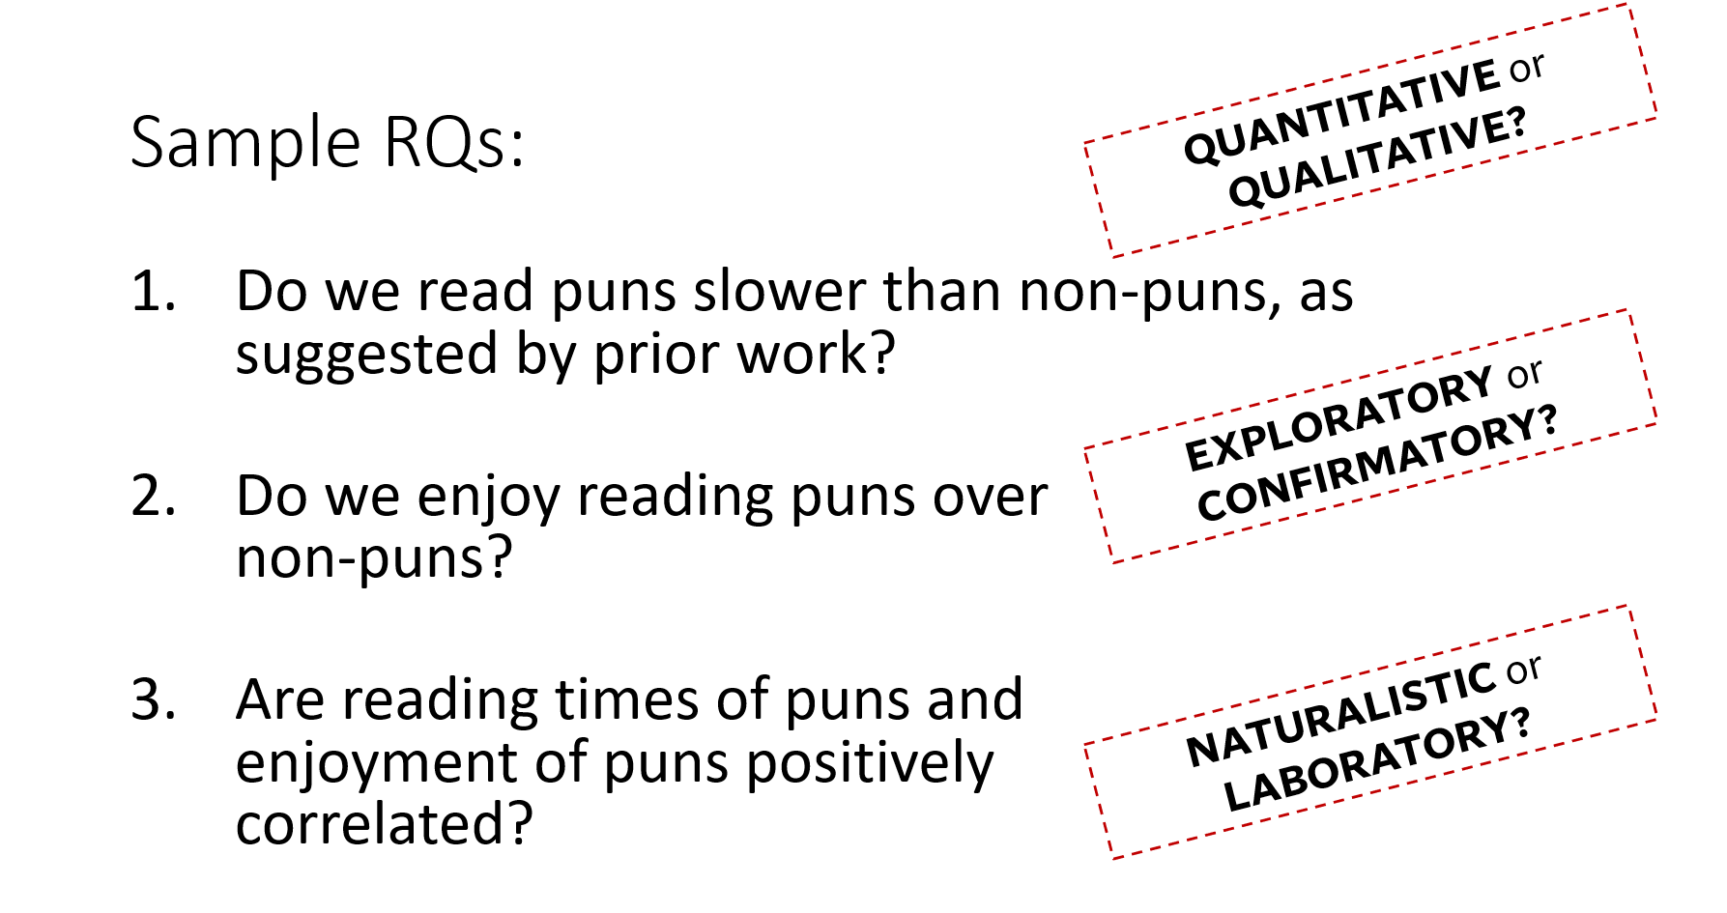
… and me?

Slide 38
Basic steps
Develop a research question (RQ)
Design/use a paradigm that addresses the RQ
Run the damn football thing!
Analyze the results

Slide 39
John, check the results!*
*And embarrass yourself (potentially).

Slide 40
4. What’s next?

Slide 41
It’s your turn now!
Proposing a project (or some project ideas) based off of some broad research questions that we will whittle down [Tuesday, 10/31]
Developing an outline that considers the information that you’ll need to gather [Thursday, 11/02]
Actually researching and designing [In-class work]

Slide 42
Thank you!

Slide 43
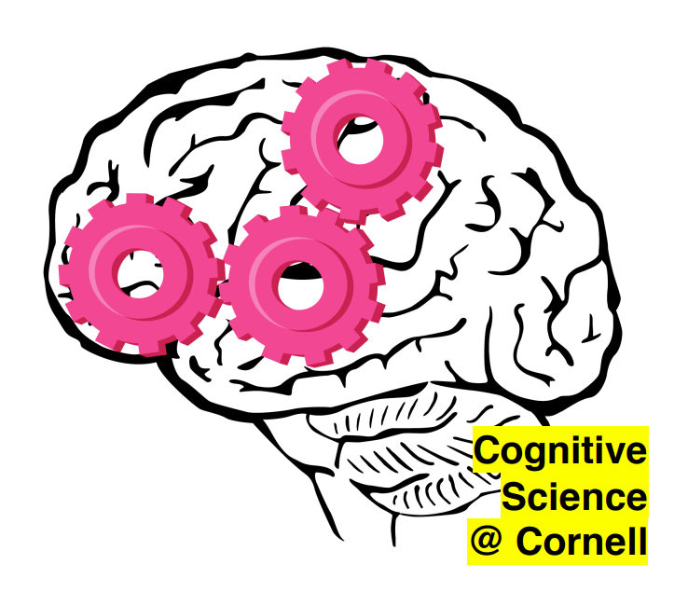





Acknowledgements
Marten van Schijndel
Draga Zec
Helena Aparicio

